Slide 1
UDP

Slide 2
UDP: User Datagram Protocol [RFC 768]
“no frills,” “bare bones” Internet transport protocol
“best effort” service, UDP segments may be:
lost
delivered out of order to app
connectionless:
no handshaking between UDP sender, receiver
each UDP segment handled independently of others
Why is there a UDP?
no connection establishment (which can add delay)
simple: no connection state at sender, receiver
small segment header
no congestion control: UDP can blast away as fast as desired

Slide 3
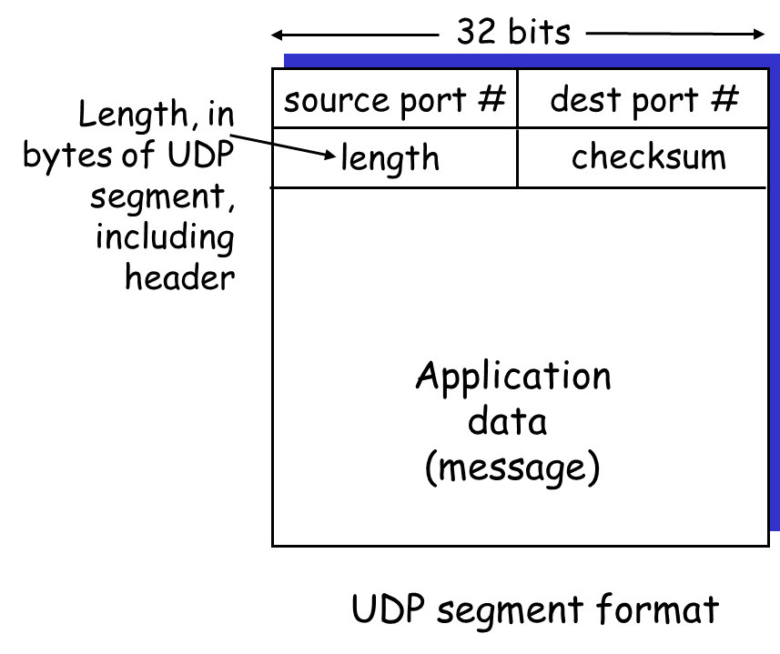
UDP: more
often used for streaming multimedia apps
loss tolerant
rate sensitive
other UDP uses
DNS
SNMP
reliable transfer over UDP: add reliability at application layer
application-specific error recovery!

Slide 4
UDP checksum
Goal: detect “errors” (e.g., flipped bits) in transmitted segment
Sender:
treat segment contents as sequence of 16-bit integers
checksum: addition (1’s complement sum) of segment contents
sender puts checksum value into UDP checksum field
Receiver:
compute checksum of received segment
check if computed checksum equals checksum field value:
NO - error detected
YES - （maybe）no error detected. ….

Slide 5
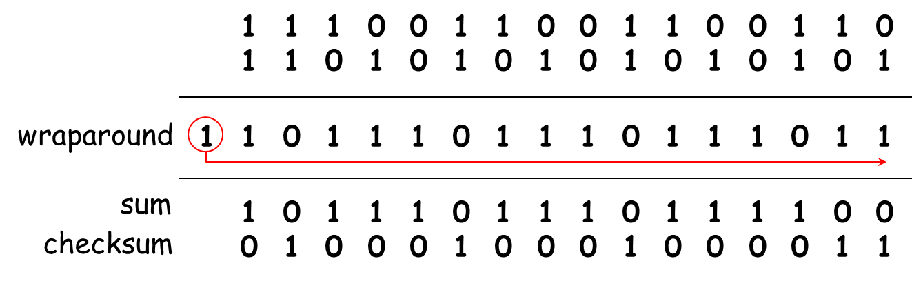
Internet Checksum Example
Note
When adding numbers, a carryout from the most significant bit needs to be added to the result
Example: add two 16-bit integers

Slide 6

Summary
What’s UDP
UDP checksum

